Slide 1

In Bound and Out Bound Marketing

Slide 2
Inbound Marketing
Pros and Cons
Pros
Cost effective
Source of reliable information
Non-invasive
Builds long term relationships
Can go viral
Cons
Time consuming
Tracking ROI
Competitive
Diverse skills required
Expensive in terms of time
https://www.animusrex.com/insights/2017-06-13-the-top-5-pros-and-cons-of-inbound-content-marketing

Slide 3
Inbound vs. Outbound Marketing
Technology is making traditional (outbound) marketing such as cold-calling, print advertising, T.V. advertising, junk mail, non-solicited email and trade shows less effective and more expensive.
Inbound Marketing is marketing focused on getting found by customers.
Learn how to attract highly qualified customers to your business like a magnet instead of interrupting people with various forms of outbound marketing

Slide 4
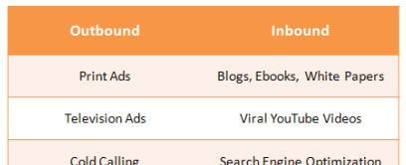
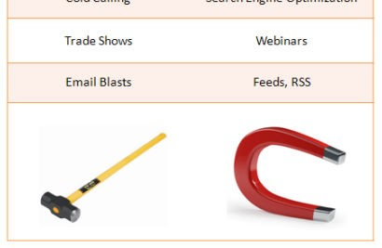
Inbound vs. Outbound Marketing
Sell to customers through promotion of features, benefits.
Attract customers through giving away great content.
Earn trust and build an audience that buys later based upon perceived brand value and reputation.

Slide 5
Inbound vs. Outbound Marketing
Outbound Marketing is PUSH
  The Model: based upon interruption, distraction, solicitation.
  The Budget: usually costs money.
  The Media Plan: optimizing advertising dollars wisely can be tough.
Challenges: TIVO, Caller ID, Do Not Mail, Email Overload, Rising Costs
Inbound Marketing is PULL
  The Model: Inbound Marketing is based upon the Law of Attraction
    …and I’m not talking about The Secret.
  The Budget: soft costs, time and resources. Some hard costs.
  The Media Plan – is supplemented with a Content Strategy Plan.
    Customers are researching, needing to find information. Be there to receive them and graciously give away what they are looking for.
Challenges: using your brain versus your budget, being compassionate for your customers and passionate about your products and services.

Slide 6
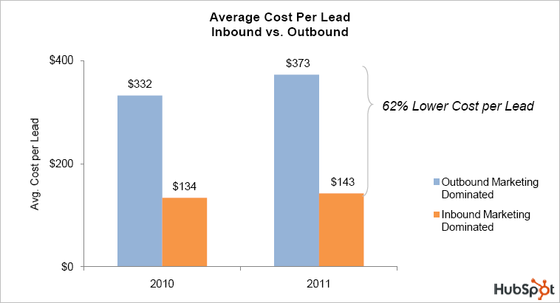
Avg. Cost per Lead: Inbound vs. Outbound
According to HubSpot, on average Inbound leads cost 60% less than Outbound Leads, generated by paid advertising – 2009, 2010 State of Inbound Marketing Reports - Two Years of Data.

Slide 7
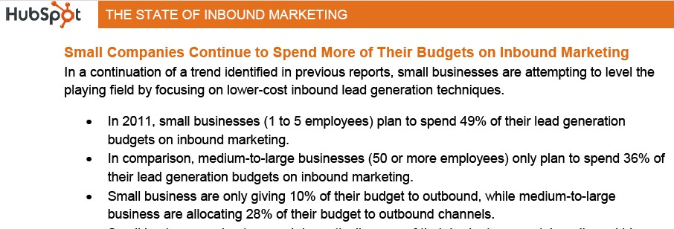
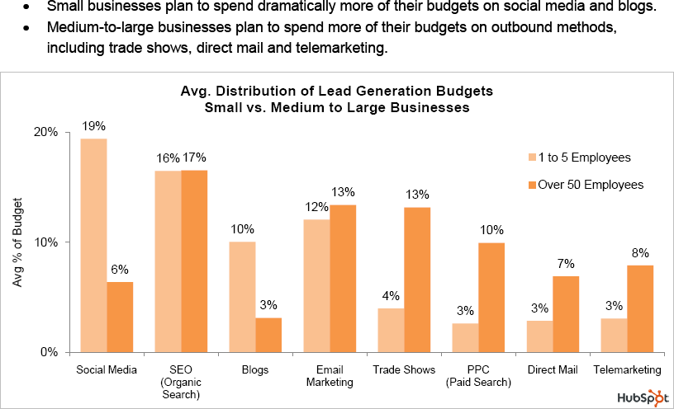
Inbound Biggest Winners: Small Businesses

Slide 8
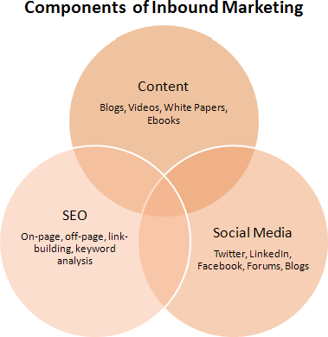
Inbound Marketing: 3 Components
Source: HubSpot 2011

Slide 9
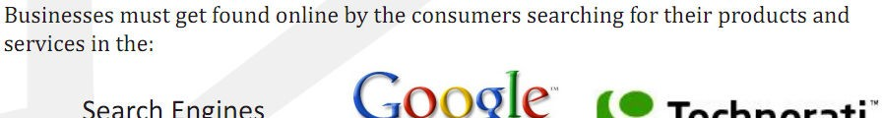
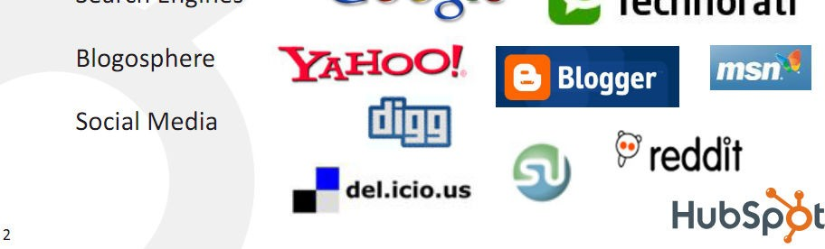
Inbound Marketing: 3 Components

Slide 10
Customer Behavior by Component
Search Engines
  Enter product/service keywords in Google/Bing
Blogs
  Research, read and get valuable free insights from the experts (your brand) to make an informed decision.
Social Media
  Observe friends behaviors with Brands (endorsement)
  Seek opinions, ratings, reviews.

Slide 11

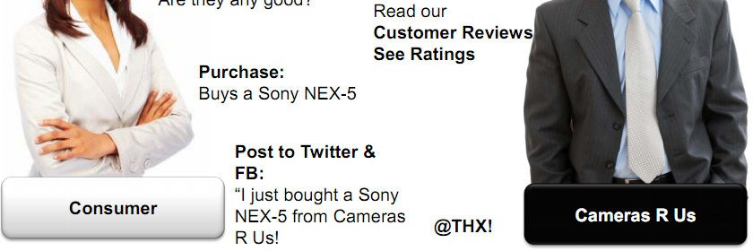
Customer Behavior by Component
Blog
Source: Lee Odden TopRankMarketing.com, SES 2011 (June)

Slide 12

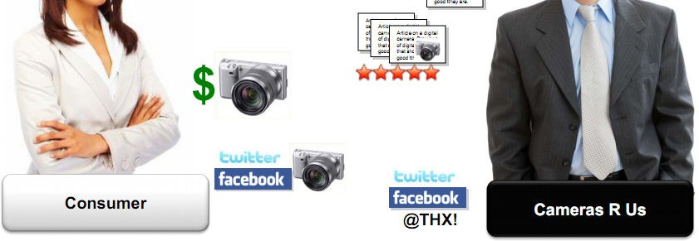
Customer Behavior by Component
Source: Lee Odden TopRankMarketing.com, SES 2011 (June)

